Slide 1
Year 2 PhD Day
Keeping up the momentum
TRAINER’S NAME

Slide 2





Housekeeping
Notes:
Go through housekeeping. Also establish rules around confidentiality – what is said here, stays here – and importance of this.

Slide 3
Outline of the session
Reflect on your progress so far
Identify what may hinder or help your progress
Unhelpful beliefs/feelings/behaviours & tips to combat them
Understand stress and how to manage it
A reminder of the importance of looking after your mental wellbeing and where you can go for support

Slide 4
Introductions
Name
Department
Your research (in a sentence)
What you enjoy (or used to enjoy) doing outside your PhD
Notes:
In groups of 4-6
[ONLINE: recommend smaller groups of 4 as it can be more difficult to share, or share in chat in the main room]

Slide 5
Progress over time: expectation
Progress
Time
Notes:
When starting the PhD, the expectation is that you will be making steady progress during the 3 years

Slide 6

Progress over time: reality
Progress
Year 2
Time
Notes:
However, in Year 2, it’s often the case that the project might change shape and you may have to start rethinking about your research from a different angle. This might lead to feeling unmotivated. This session aims to help you keep the momentum and remind you of ways in which you can stay mentally well during this time.

Slide 7
Where are you now?
What challenges have you had (academic, practical, personal)?
What’s going well?
Think about this on your own – then share whatever you feel comfortable sharing in small groups.
Notes:
What’s going not so well?
What’s going well?
In small groups and then on tables: A bit of a warm up exercise to lead into the Force Field Activity.
NB collect things that haven’t gone so well first so that you end on a positive note

Slide 8
Unhelpful beliefs / feelings / behaviours
Notes:
Go through each area that follows with examples.

Slide 9
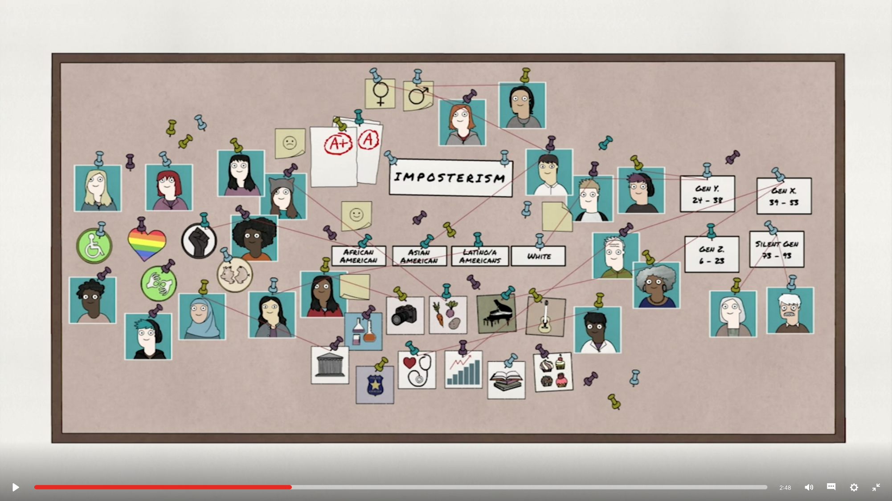
Imposter Syndrome / Self-doubt
Notes:
https://www.ted.com/talks/elizabeth_cox_what_is_imposter_syndrome_and_how_can_you_combat_it?utm_campaign=tedspread&utm_medium=referral&utm_source=tedcomshare

Slide 10
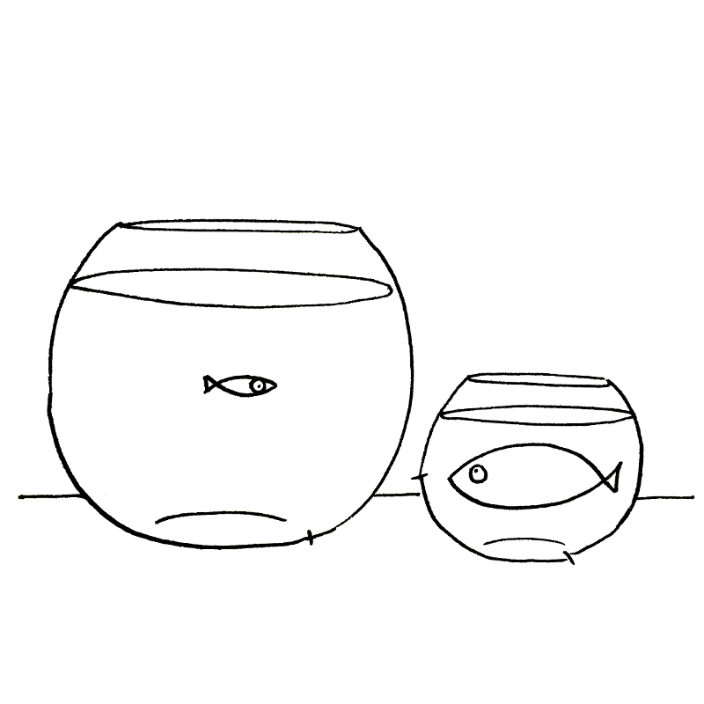
Comparing yourself to others
“everyone’s better than me”
Notes:
Can lead to lack of confidence.
Remind them that we often only see the successes of others and not their failures. We also only see what we want to see (eg that fish is bigger than me! vs that fish has so much space in its bowl!)

Slide 11
Procrastination / lack of motivation
Notes:
PGRs often procrastinate as research tasks are often massive and long-term (eg write 80,000 words in 3 years). This can make them feel paralysed and they will avoid starting a task. Other contributing factors: fear of failure, unclear about how to perform a task, lack of guidance.

Slide 12
Activity: Force Field Analysis
Set SMART goals
Identify what might prevent you from reaching your goal (eg behaviours above, equipment, access to supervisor etc)
Identify what could help you reach your goal
Notes:
Explain the exercise. This is to be done as individuals and then they can collect some of the information on flipchart paper as a whole table – collecting examples of the kind of things that help and hinder

Slide 13
Activity: Force Field Analysis
Step 1: Complete exercise on your own
Step 2: On your table create lists of factors that help and factors that hinder
  What actions could you take to eliminate the unhelpful, hindering forces and maximise the helpful, facilitating driving forces?
Notes:
Explain the exercise. This is to be done as individuals and then they can collect some of the information on flipchart paper as a whole table – collecting examples of the kind of things that help and hinder
[ONLINE: run Step 2 in breakout groups of 4 – maintain the same groups that you used for the introductions]

Slide 14
Practical tips to tackle procrastination/ lack of motivation
Break all goals into smaller achievable tasks
Rank tasks in terms of difficulty. Start with easiest
Turn off notifications (mobile or browser blockers)
Email: set specific times to check
Pomodoro technique or similar

Slide 15
Let’s revisit mental health and wellbeing
Remember we all have ‘mental health’
Mental health is on a continuum
Mental health problems can happen to everyone
Looking after your mental wellbeing makes you more resilience to withstand the strains and stresses of live (and being a PG researcher)
Notes:
Mental health is on a continuum, similar to physical health
Common MH problems - anxiety and depression are the most common
Explain that like physical health mental health is on a spectrum – which good mental health at one end and serious MH condition at the other (eg Bi-polar affective disorder). Explain that we can move along the continuum. Also clarify that experiencing human emotions such as fear, sadness, anger, worry, grief does not mean you are having MH problems. When these become overwhelming, long-lasting and you can’t bounce back – this means that they might be developing into MH problems. Better to address sooner rather than later.

Slide 16
What is stress?
Thinking about yourself and others, what is stress and what can it do to our:
Feelings
Thoughts/beliefs
Behaviour
Physical health
Discuss how stress affects each area
Notes:
Stress is very common and if long-term, it can affect our mental health
Go through each area
Feelings: sadness, anxiety, worry, panic, vulnerability, irritable, bad-tempered, short fuse;
Thoughts/beliefs: I’m rubbish, I’ll never get this done, it’s impossible,:
Behaviour: smoking, drinking, eating, spending too much, being aggressive, shouting, going into overdrive, unable to relax (or opposite), not sleeping;
Physical health: digestive problems, skin problems, breathless, headaches, migraines, high blood pressure, tension in neck and shoulders etc
ONLINE: see next slide

Slide 17
What is stress?
Thinking about yourself and others, what can stress do to our:
Online
Feelings
Thoughts/beliefs
Behaviour
Physical health
Notes:
ONLINE
Stress is very common and if long-term, it can affect our mental health
Ask them to annotate their thoughts anonymously on the slide inside each box – then debrief based on topics that come up.
If a large group, create Jamboard slides (or equivalent) with this template in advance of the session for the same number of breakout groups you will have and share each Jam with each breakout group. They can contribute their thoughts anonymously on their own Jam and present when they come back to the main room.
Go through each area:
Feelings: sadness, anxiety, worry, panic, vulnerability, irritable, bad-tempered, short fuse;
Thoughts/beliefs: I’m rubbish, I’ll never get this done, it’s impossible:
Behaviour: smoking, drinking, eating, spending too much, being aggressive, shouting, going into overdrive, unable to relax (or opposite), not sleeping;
Physical health: digestive problems, skin problems, breathless, headaches, migraines, high blood pressure, tension in neck and shoulders etc

Slide 18
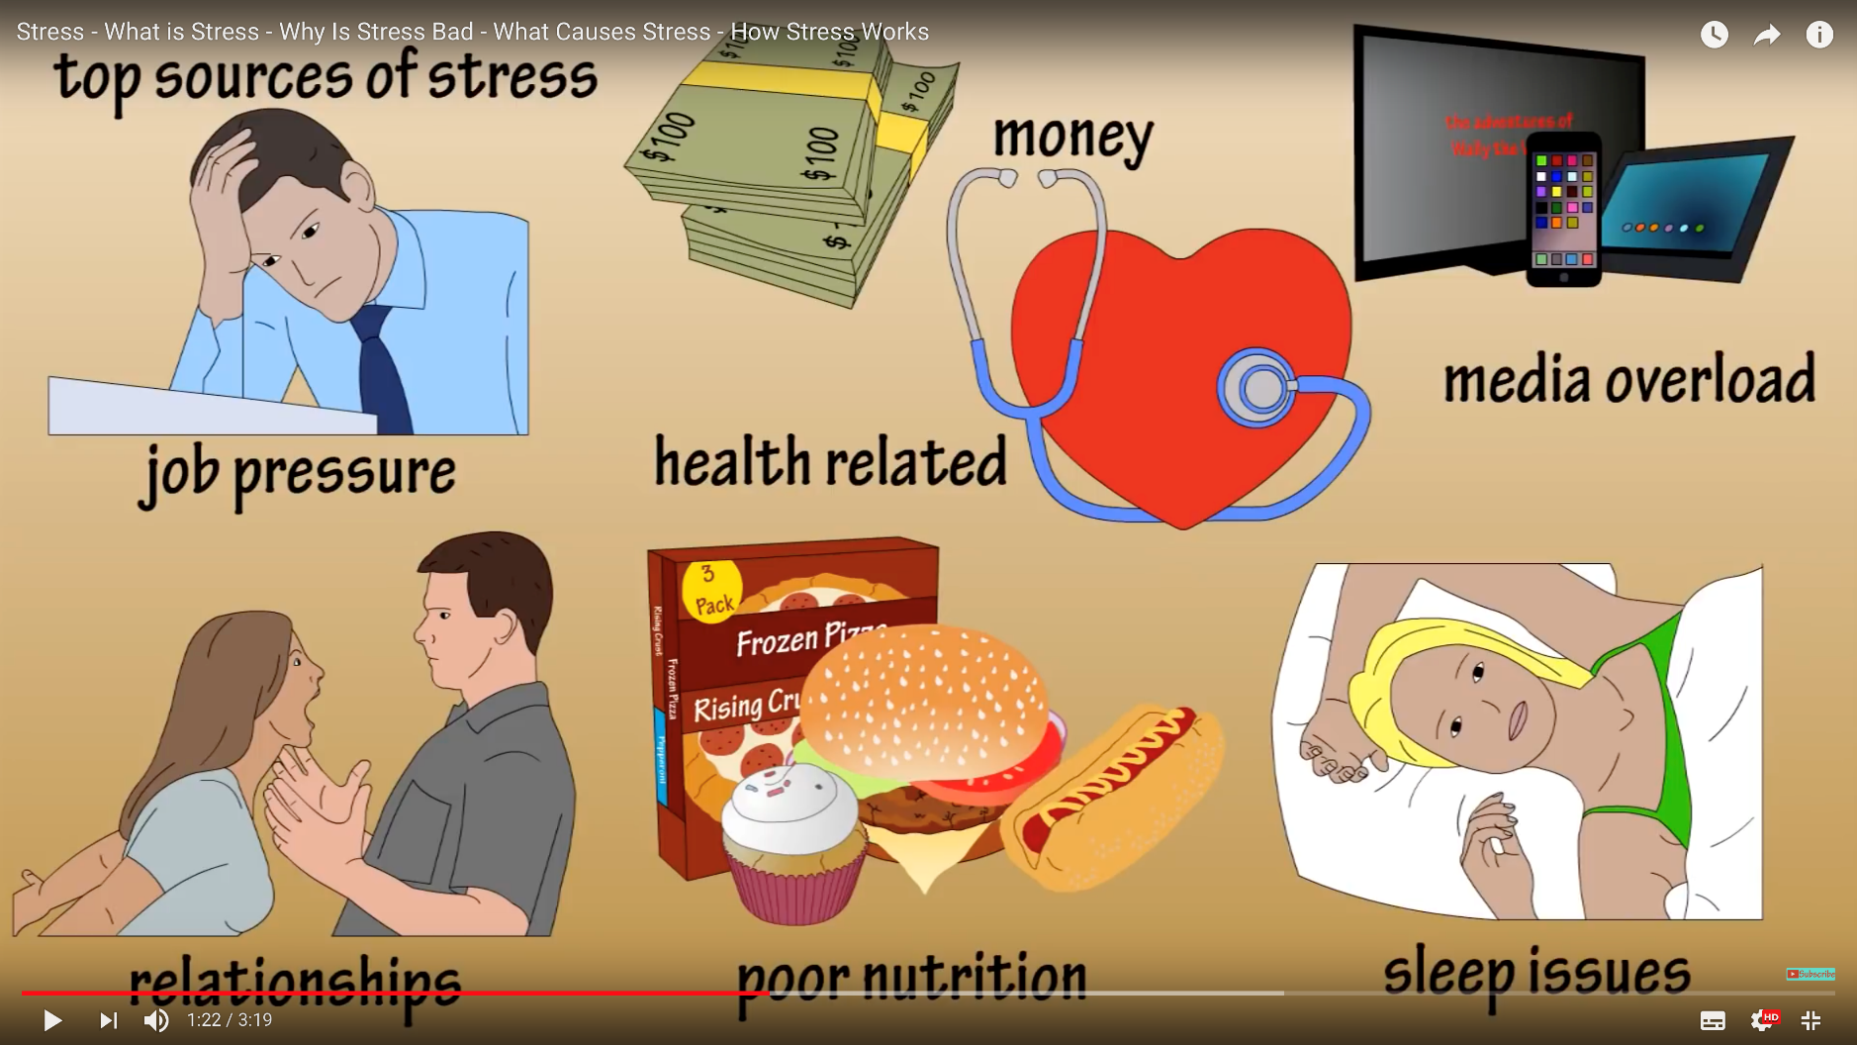
What is stress?
Notes:
https://youtu.be/dERu8051t4w
A summary of what stress is and how it affects us

Slide 19
Activity: What is your stress container?
Stress flows into the container
If the container overflows, problems develop - “emotional snapping”
Vulnerability is shown by the size of the container
Helpful coping strategies = tap working lets the stress out
Unhelpful coping strategies = tap blocked so water fills container and overflows
Notes:
Go through container with examples of stresses, useful strategies (eg exercise) and unhelpful ones (eg alcohol). Do exercise in workbook. Those who had done it the previous year, remind them that it’s good to do it again and see if anything has changed and if they have been neglecting their helpful coping strategies.
Think about:
What are the things causing you stress?
What are you doing to manage your stress?
Is there anything you know would help but aren’t actually doing?
ONLINE: see next slide

Slide 20
Online
Stressors:
Helpful coping strategies:
Unhelpful coping strategies:
Notes:
ONLINE
If doing online, they can contribute anonymously by annotating on the slide. Again, powerful to see similar topics arising.

Slide 21
Things that help
What is one thing you enjoy or used to enjoy doing outside your PhD?
Try to maintain a good work-life balance
  35 hours a week (Full-Time)
  30 days of Annual Leave (plus bank holidays/Christmas)
Take breaks! Avoid burnouts.
Notes:
Things that help manage stress/helpful coping strategies
Check what the regulations are for work-hours and annual leave at your institution

Slide 22
Things that help
Positive self-talk/self-compassion
  Setbacks are part of doing a PhD. We learn from failures
Time management techniques
  Eg Pomodoro technique
Talk to your supervisor
  Guidance on nature, progress & standards of work
  You have a shared goal! Be honest about any problems you have
Notes:
Include any relevant training that your university might be offering (eg time management, imposterism, working with supervisor)

Slide 23
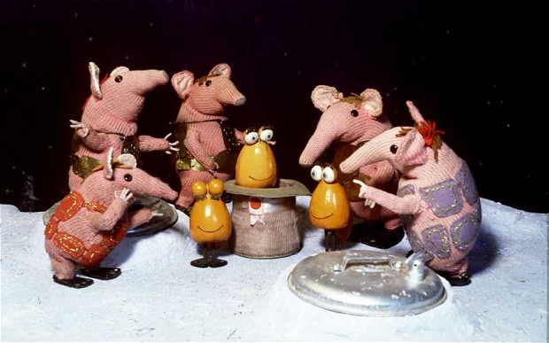
Say hello again to the CLANGERS
Connect
Learn
Be Active
Notice
Give
Eat well
Relax
Sleep
Photo: Kent news and Pictures
Notes:
Based on the 5 ways of well-being with three others. All evidence based. Go through them quickly and perhaps expand on in workbook

Slide 24
[Add slides with resources and support available at your Institution – eg training, counselling, online resources]
Notes:
Include these in workbook

Slide 25
Resolutions
Think of:
At least one unhelpful thing to stop doing
At least one helpful thing to keep doing
At least one helpful new thing to start doing as of today
Share these in pairs and make a commitment to do this.
Notes:
1 unhelpful thing to stop doing
1 useful thing to keep doing
1 useful thing to start doing
Can do more if they want!
Share in pairs
ONLINE: share in their small breakout groups of 4 participants

Slide 26
ACKNOWLEDGEMENTS
This workshop was originally developed in January 2019 by Penny Aspinall, Charlie Waller Trust, and was partially redesigned by Fryni Panayidou, Queen Mary University of London, in 2020. The development of the workshop was co-funded by the Office for Students and Research England Catalyst Fund project at Queen Mary: Supporting PGR mental health and wellbeing.
Notes:
Find out more about the great work that Charlie Waller do at https://charliewaller.org

