Slide 1
Evaluation of the Office for Students’ statement of expectations for preventing and addressing harassment and sexual misconduct affecting students in higher education
Evaluation Report – Findings from a survey of higher education providers
Helen Baird, Principal Consultant
Paul Sayles, Group Business Intelligence Manager
Kay Renfrew, Associate Consultant
Professor Graham Towl, Associate Consultant
August 2022
Ref: 2414

Slide 2
Contents
Executive summary
Background and evaluation methodology
Summary of key survey findings
Summary of conclusions
Survey findings by question
Appendices
Appendix A Methodology
Appendix B Survey questions (separately appended)

Slide 3
Executive summary
This Evaluation Report presents key findings from the analysis of the online survey of a large sample of higher education providers conducted during May 2022, as part of a broader programme of research (see Appendix A for details about the method)
The aim of the survey was to consider providers’ perspectives about the effect of the statement of expectations on their approaches to preventing and responding to harassment and sexual misconduct since it was announced by OfS in early 2020
The findings discussed in this Report are based solely on the perspectives of the providers who responded to the survey
Results of the survey indicate that the initial impact of the statement of expectations on providers’ approaches has been positive – although there are clear variations and levels of maturity evident in approaches among different types and sizes of provider
The provider survey results need to be contextualised with what we know already and is emerging from other elements of the research – for instance, early analysis of research with other groups, such as students and their representatives and experts indicates different perspectives about the progress being made by providers on tackling harassment and sexual misconduct – see also our Evaluation Update on themes emerging from research with students
Our final report triangulates findings from the full range of data sources, including aspects of the qualitative research with other groups. It will give a detailed analysis and synthesis of all the various strands of research undertaken for the evaluation.

Slide 4
1: Background and evaluation methodology

Slide 5
Background to the evaluation
The Office for Students (OfS) announced through a sector consultation in January 2020 a statement of expectations for colleges and universities (providers)
‘to help them to develop and implement effective systems, policies and processes to prevent and respond to incidents of harassment and sexual misconduct’
A final statement of expectations was published in April 2021 and providers were invited to review and update their systems, policies and processes during the 2021-22 academic year
The aim of the statement is to help ensure that
‘all higher education students registered at a provider, however and wherever they may be studying should be protected from harassment and sexual misconduct from other students, staff and visitors’
A team from SUMS Consulting was appointed to conduct an independent evaluation of the initial impact of the statement of expectations (during the period March to September 2022)

Slide 6
Evaluation framework and key themes
SUMS’ evaluation team is seeking to understand the extent to which the statement of expectations has contributed to
Changes in higher education provider behaviour
The underlying issue of harassment and sexual misconduct
Student experiences and outcomes related to prevention and response to harassment and sexual misconduct
Key evaluation aims are to
Examine how higher education providers have responded to the statement of expectations
Hear from students and students’ unions on whether things changing for the better
Consider whether further change in this area may be needed

Slide 7
Evaluation framework and key themes
Evaluation framework - key themes
The contribution of the overall statement of expectations to any changes
The OfS' approach to disseminating the statement of expectations
#1Taking a whole provider approach
#2 Embedding in governance structures
#3 Engaging students and co-creation of policies and processes
#4 Prevention; training of staff and students and awareness raising
#5 Reporting and referral policies and processes
#6 Approach to taking action in response to misconduct
#7 Provision of support to students
Implications and informing future decision-making
Understanding intended longer-term impact from the statement of expectations

Slide 8
Online survey of higher education providers
This report focuses upon the findings and emerging conclusions from the online survey
The survey was sent by OfS on SUMS’ behalf to accountable officers of 100 HE providers (sample of 25% of providers registered with OfS) requesting a corporate response
Cluster based random samples were generated to make sure the sample reflected provider type, size (of student body) and region
The survey considered the effects of the statement of expectations on providers’ approaches to preventing and responding to harassment and sexual misconduct to date through a series of quantitative and open-ended questions, some of which probed what changes had taken place over time
The overall response rate was high at 68% - with some variation in response by type of provider (ranging from 87% for ‘research-intensive’ providers to 43% for ‘other provider (with >1,000 FTE students)’
Analysis of this survey’s results includes comparison of some key measures with directly comparable questions used by Universities UK in a 2018 survey discussed in the UUK report Changing the Culture: Two Years On
Appendix A gives details about the survey methodology and a separate Appendix B contains the survey questions used
*Note that all responses to the survey have been aggregated in SUMS’ analysis and no individual organisation has been identified to OfS in any briefings or reports arising from the research. All quotes have been anonymised and any identifying information about organisations removed.

Slide 9
2: Summary of key survey findings

Slide 10
Overview of key survey findings (I of II)
Influence of the statement of expectations on providers’ approaches
Relative contribution of the statement of expectations
Changes in volumes of reports and disciplinary proceedings
Respondents indicated that the statement of expectations has been one of the most important factors in shaping providers’ approaches over past two years, compared with other interventions and factors
84% of responding providers indicated that OfS’ statement of expectations has influenced their approaches for preventing and responding to harassment and sexual misconduct over the past two years
This varies across types of provider – and it suggests that the statement has been far more influential for universities than for FE colleges and other types of provider
Responding providers indicated that the volume of sexual misconduct reports has increased in over half (57%) of the responding providers over the past two years – however the volume of disciplinary proceedings did not increase at a corresponding rate
Other key influences on responding providers’ approaches indicated have been harassment and sexual misconduct incidents affecting their own students, and input from victim-survivors of harassment and sexual misconduct
Highest increases in sexual misconduct reports were within responding ‘research intensive’ and ‘post-92’ universities
Responding providers indicated there has been less change in reporting of other forms of harassment over the past two years – and in related disciplinary proceedings (in over half of responding providers these have stayed about the same)
Increasing reports of harassment and sexual misconduct suggest that students have greater confidence that their provider will respond positively

Slide 11
Overview of key survey findings (II of II)
Leadership and governance
Prevention of harassment and sexual misconduct
Responding to harassment and sexual misconduct
Accountability for tackling harassment and sexual misconduct is within more senior leadership teams now (across all provider types)
Common preventative activities: collaboration with students’ unions or similar bodies, awareness-raising campaigns and collecting data on reported incidents ​
Over 60% of providers said they have implemented the Pinsent Masons guidance on handling situations where a student disciplinary offence may also constitute a criminal offence – but 20% have not yet started to do so
91% of providers offer support to both reporting and responding students when a disclosure is made
Over 70% of providers indicated that they have fully implemented communicating the outcome of investigatory processes and any actions the provider has taken to both the reporting and responding students
Most providers indicated that their students can report incidents of harassment or sexual misconduct in-person, but online reporting is available at only 75% of the providers
Governing bodies / boards are more involved in ensuring their organisation’s approach to addressing harassment and sexual misconduct is adequate and effective
Less common activities: engaging with local schools and colleges to ensure a joined-up approach, and publishing data on reported incidents or the outcomes of cases ​
Students and staff undertake relevant training in most providers, but this is not usually mandatory; where mandatory training exists this is for sexual consent training for students, and awareness-raising and handling disclosures training for staff; a clear issue for providers is in resourcing specialist investigations

Slide 12
3. Summary of emerging conclusions

Slide 13
Emerging conclusions (I of II)
The response rate to this survey of higher education providers (68%) was high. It was sent by OfS on the evaluation team’s behalf to accountable officers in a large sample of 100 providers (roughly a quarter of OfS’ register). This perhaps suggests that interest in this area is high and that the context may have changed from when the OfS launched the statement of expectations.
There were variations in responses to many of the survey questions by different types and sizes of provider. A clear distinction is apparent between the type of impact the statement of expectations has had on responding ‘research-intensive’ and ‘post-92’ providers (traditional higher education institutions), compared with ‘FE college’, ‘small and specialist’ and ‘other’ ‘providers.
This reflects existing differences in in resources available to support this area, and/or how developed providers’ systems, policies and processes were for preventing and responding to harassment and sexual misconduct prior to the issue of the statement, and therefore how has it been used by different parts of the sector. FE college providers must meet statutory safeguarding requirements for their under-18 students so considered the statement alongside these.
Overall, the provider survey results are positive and indicate signs of progress having been made since 2020. Responding providers indicated that accountability for tackling harassment and sexual misconduct may be moving to more senior staff and that governing bodies have greater oversight. This is indicative of a whole organisation approach, which is necessary for culture change to take place.
However, the survey results also suggest gaps in training provision and limited mandatory training, and only 60% of responding providers have fully implemented the Pinsent Masons guidance on when misconduct may also constitute a criminal offence.

Slide 14
Emerging conclusions (II of II)
While over half of responding providers indicated that the volume of reports of sexual misconduct has increased over the past two years, these have stayed about the same for other forms of harassment
This may suggest that students are becoming more confident in coming forward to report sexual misconduct in just over half of the providers
Though they are less so about other forms of harassment – there may be other factors influencing reporting such as an understanding of what constitutes other harassment and the importance of reporting it
However, most of the responding providers do not know the levels of underlying prevalence so it is difficult to contextualise these findings – only 25% of the providers indicated that they collect prevalence data, and this is not done at national level.
Findings from the evaluation team’s research with other stakeholders via roundtable discussions, focus groups and interviews with staff and students on the ‘frontline’ (including survivors, student representatives, campaigners, practitioners and academic experts) suggest that there is a mismatch in perspectives about the progress being made in this area (and the need for further potential changes) between different groups.
Finally, the OfS statement of expectations refers throughout to ‘harassment and sexual misconduct’. A mistakenly held and widespread assumption which is apparent from many of the qualitative response to the survey and from other elements of the evaluation research is that the statement of expectations is only focussed on sexual misconduct, as opposed to all the forms of harassment*.
Findings suggest there is scope to enhance the statement and how it is applied across the sector, to help ensure equity for students and staff
* In the statement of expectations harassment is defined as in Section 26 of the Equality Act 2010. It also includes domestic violence and abuse (which can also involve control, coercion and threats) and stalking. Additionally harassment includes any incidents of physical violence towards another person(s) on the basis of a protected characteristic and hate crimes, such as those criminal offences, which are perceived by the victim or any other person to be motivated by hostility or prejudice, based on a person's disability or perceived disability; race or perceived race; or religion or perceived religion; or sexual orientation or perceived sexual orientation or transgender identity or perceived transgender identity.

Slide 15
4. Survey findings – by question

Slide 16
How influential has the statement of expectations been on the development and implementation of your organisation’s approach to prevent and respond to harassment and sexual misconduct over the past two years?
The statement of expectations (SoE) was at least somewhat influential for 84% of providers in developing and implementing approaches to preventing and responding to harassment and sexual misconduct over the past 2 years (see the chart on the next slide for details)
Varying levels of influence of the SoE are evident across different provider types* and sizes** – it has been at least somewhat influential for
100% of post-92 providers (16 responses)
92% of research-intensive providers (13 responses)
50% of FE providers (18 responses)
100% of ‘medium’ and ‘large’ providers (9 and 14 responses respectively)
56% of ‘micro’ providers (18 responses)
*Provider type - Research-intensive, Small and specialist, Post-92, FE college, Other provider (>1,000 FTE students), Other provider (<1,000 FTE students)
** Provider size by student FTEs: Very large (>19k), Large (10-19k); Medium (2k-10k); Small (500-2k); Micro (<500)

Slide 17
Influence of the statement of expectations on providers’ approaches in past two years by provider type and size

Slide 18
If the statement of expectations has influenced your approach please tell us in what ways, and if it has not done so please tell us why this is the case
Comments made suggest that the SoE provided a framework for the development of providers’ institutional policies, processes and procedures (48% of comments suggested this)
A similar number of comments suggests that the SoE acted as a catalyst for review and updating of existing approaches, processes and procedures
This included acting as a benchmark against which to measure approaches taken; again, almost half of the responses (31 comments (47%) made reference to this
“This has provided a framework for us to be able to develop necessary support and information to our campus community” Small and specialist provider
“The expectations have set a benchmark for us to meet and exceed. They also provide a framework for internal reporting.” Research-intensive provider
“The expectations have formed the basis of our institution's approach in this respect and informed actions within the College's wider EDI development plan” FE College provider
“It led us to undertake a comprehensive review of policies and procedures and also to ensure that there was a focus on student and staff training and awareness raising.” Other provider
“We have reviewed and updated all of our core/key policies, informed by the OfS expectations and in collaboration with our students’ union. We have also delivered training to twenty senior colleagues (again, including our SU) in relation to sexual misconduct, informed - in part - by the OfS expectations. The OfS expectations - and our response to them - have also been discussed at various University committees, including at Board of Governors level.” Post-1992 provider

Slide 19
How important have the following factors been in how your organisation’s approach to preventing and responding to harassment and sexual misconduct has developed over the past two years?
Three of the most important factors for providers were (see the chart on next slide)
Incidents of harassment and sexual misconduct affecting students
Input from victim-survivors of harassment and sexual misconduct
Office for Students’ statement of expectations
Three of the least important factors for providers were
ProtectEd’s accreditation scheme
GuildHE’s Anti-Racism Programme
Office for Students Catalyst safeguarding project funding
Other important factors mentioned in the open ‘other’ category included: 1752 Group guidance on staff to student harassment and sexual misconduct, and Department for Education and Ofsted guidance for FE colleges

Slide 20
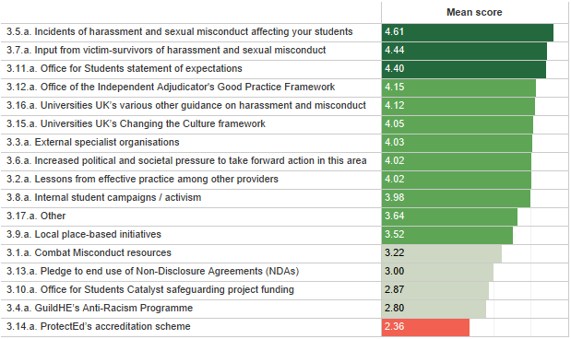
How important have the following factors been in how your organisation’s approach to preventing and responding to harassment and sexual misconduct has developed over the past two years?

Slide 21
Relative importance of the statement of expectations –respondents’ reasons for responses and illustrative comments
37 comments were given to this question which recognised that the various factors listed had been important (to varying extents) – in addition
10 of the comments highlighted that current activities are a continuation of previous work in this area
5 of these also noted specifically that their work is a continuum of that started as a result of Universities UK’s Changing the Culture framework (published in 2016)
6 comments referred to being “student centred” institutions, and so therefore responsive to issues impacting upon students including this one
“Informed use of external resources and experiences, but work - and commitment to improve in this area - pre-dates sectoral initiatives” Small and specialist provider
“Our work in this area began in earnest in 2015, influenced by student campaigns / activism and incidents of harassment fuelled by lad culture. This resulted in the launch with our students' union of our [awareness raising] campaign. Catalyst funding allowed us to deliver student led peer to peer bystander training, supported by academic research. In recent years, as well as being influenced by the statement of expectations, we have been heavily influenced by the lived experience of our students and our ongoing close working with our students' union.” Post-92 provider

Slide 22
Has the volume of reported incidents of sexual misconduct affecting students changed at your organisation over the past two academic years (since academic year 2019/20)?
Any increase in the volume of reports is an important indicator of positive change. Increasing reports suggest that students have greater confidence that their provider will respond positively. However, the true prevalence remains unknown as many victim-survivors do not come forward and most providers do not carry out climate surveys.
Overall, 57% of respondents stated that the volume of reported incidents relating to sexual misconduct affecting students had increased or considerably increased over the past two years –although for 43% of providers this has stayed about the same (see details on the chart on the preceding slide)
There were clear variations by provider type in reported increases – the volume of reports had increased or considerably increased in the period for the following (noting these are based on small sub-sample sizes)
93% of post-92 providers
77% of research-intensive providers
50% of small and specialist providers
33% of FE colleges
17% of other providers

Slide 23
Has the volume of disciplinary procedures relating to sexual misconduct affecting students changed at your organisation over the past two academic years?
Overall, 44% of respondents stated that the volume of disciplinary procedures relating to incidents of sexual misconduct had increased or considerably increased since 2019/20 – but for a higher proportion (54%) these had stayed about the same over the two-year period (see chart on preceding slide)
This is a lower rate of increase than that for the volume of reported incidents. This suggest that although providers have seen an increase in reporting of sexual misconduct over the period, the volume of disciplinary proceedings has not increased at a corresponding rate
There are also clear variations by type of provider in terms of whether they have seen increases in disciplinary procedures, and whether these have increased at the same rate as reports being made (noting these are based on small sub-sample sizes)
77% of research-intensive providers saw an increase in disciplinary procedures relating to sexual misconduct – the same rate of increase seen in reporting of sexual misconduct
69% of post-92 providers saw an increase in disciplinary procedures – a lower rate of increase seen in reporting of sexual misconduct
42% of small and specialist providers saw an increase in disciplinary procedures – a similar rate of increase to that of reports of sexual misconduct
Just 17% of FE colleges saw an increase in disciplinary procedures – a lower rate of increase seen in reporting of sexual misconduct

Slide 24
Has the volume of reported incidents of other forms of harassment affecting students changed at your organisation over the past two academic years?
Overall, 59% of respondents stated that the volume of reported incidents of other forms of harassment affecting students has stayed about the same since 2019/20; while for 38% this had increased
This is a considerably lower rate of growth in reports of other forms of harassment than the increase seen in reports relating to sexual misconduct – suggesting that students may be less confident in coming forward to report incidents of harassment and in their providers’ response
There were also clear variations by provider type in increases to the volume of reports of other forms of harassment (noting these are based on small sub-sample sizes)
75% of post-92 providers stated the volume of reports increase or considerably increase
50% of small and specialist providers saw the volume of reports increase or considerably increase
46% of research-intensive providers stated that the volume of reports increase or considerably increased
Just 11% of FE colleges saw the volume of reports increase or considerably increased

Slide 25
Has the volume of disciplinary procedures of other forms of harassment affecting students changed at your organisation over the past two academic years?
Overall, 60% of respondents stated that the volume of disciplinary procedures relating to other forms of harassment and incidents of hate had stayed about the same since 2019/20; while 38% said these has increased
This rate of increase corresponds with the increase seen in the volume of reports of other forms of harassment
There are clear variations by type of provider in terms of whether they have seen increases in related disciplinary procedures, and whether these have increased at the same rate as reports being made (noting these are based on small sub-sample sizes)
69% of post-92 providers saw an increase in disciplinary procedures relating to other forms of harassment – a slightly lower rate than the increase in reported incidents
62% of research-intensive providers saw an increase in disciplinary procedures relating to other forms of harassment – a substantially higher rate than the increase in reported incidents
42% of small and specialist providers saw an increase in disciplinary procedures relating to other forms of harassment – a slightly lower rate than the increase in reported incidents (slightly lower than reported incidents)
11% for FE colleges saw an increase in disciplinary procedures relating to other forms of harassment – a slightly lower rate than the increase in reported incidents

Slide 26
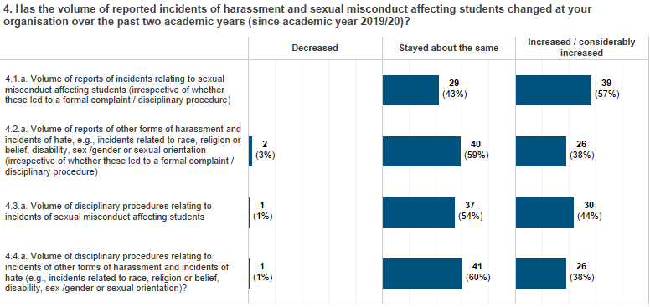
Has the volume of reported incidents of harassment and sexual misconduct affecting students changed at your organisation over the past two academic years*?
*Note: the Covid pandemic has been over this same period and will have had an impact in different ways on the volumes and types of incidents

Slide 27
Reasons why any changes in the volume of reports or disciplinary procedures may have taken place
50 providers added open text responses to this question and analysis of these showed that
28 providers attribute positive changes in volumes to awareness raising campaigns over the period
11 responses relate this to issues of harassment and sexual misconduct being an ongoing and growing area of concern in society more generally
9 responses relate to there now being internal support available for disclosures to be made
10 responses relate to the introduction or improvement of reporting mechanisms
“Awareness raising has highlighted the issues and encouraged more complaints, students feel safer in reporting incidents” FE provider
"Personal view is our campaigns and our sexual violence liaison service has encouraged students to come forward, in addition to development of external partners and relationships.“ Post-1992 provider
“Better reporting mechanisms. Increased awareness of reporting mechanisms. Confidence building with complainants in systems to manage reports. Improved awareness of disciplinary procedures and action that can be taken. Student expectations for action to be taken. Social change leading to increased awareness of abuse. Social change leading to increased disclosure of misconduct.” Research-intensive provider
“When we first introduced our policy and procedures, and publicised how to make disclosures and what we would do about them, we saw a small increase (previously we rarely received any disclosures - we are a small specialist institution). This has not significantly changed since the implementation of our policy and procedures in 2019. Students are however more likely to call out and call in their peers, as they know they will have institutional support.” Small and specialist provider

Slide 28
Who was accountable for leading on this area at your organisation (as opposed to the day-to-day operational activity) in 2019/20 and in 2021/22?
The survey results indicate that accountability for tackling harassment and sexual misconduct is held by more senior officers and at senior leadership team level now (across all provider types) compared with two years ago
There has been an increase among providers in the number of heads – Vice Chancellor, Principal (or similar) – who are now accountable for leading this area (12% now, up from 4% in 2019/20 – though the numbers remain small)
Over the same period, there has been a decrease in Directors of Student Services (or similar) who are accountable (26%, down from 41%) – although this remains the most popular answer of all types
There is variation in where accountability sits by provider type (see the chart on the next slide for more details)
Directors of Student Services (or similar) are accountable at 50% of FE colleges
Pro Vice Chancellor, Deputy Principal (or similar) roles are accountable at 50% of post-92 providers (compared to 25% for all respondents)
Chief Operating Officer, Registrars or similar are accountable at 62% of research-intensive institutions – compared with just 23% in 2019/20

Slide 29
Who was accountable for leading on this area at your organisation (as opposed to the day-to-day operational activity) in 2019/20 and in 2021/22?

Slide 30
Leadership and accountability for tackling harassment and sexual misconduct – Comparison with UUK’s 2018 survey
We compared the survey results with responses to comparable questions used by Universities UK in a 2018 survey discussed in the report Changing the Culture; Tackling Gender-based Violence, Harassment and Hate Crime: Two Years on
UUK’s 2018 survey covered only traditional higher education institutions (HEIs) whereas the survey for this evaluation covered all types of providers on the OfS’s register. Therefore, we used our evaluation survey results from HEIs only for this part of the analysis (excluding the FE and other small HE providers) to enable some additional comparison of any changes over time
While the numbers are small, some of the changes indicated from this analysis includes the following
Directors of Student Services (or similar) being accountable has decreased (17% compared to 26% in the UUK survey)
More senior roles such as Chief Operating Officer, Registrar, and Academic Registrar are accountable for this area now than was the case in 2018

Slide 31
Leadership and accountability for tackling harassment and sexual misconduct – Comparison with UUK’s 2018 survey

Slide 32
In what ways did your Governing Body / Board ensure that your organisation’s approach to addressing harassment and sexual misconduct affecting students was adequate and effective two years ago compared with now?
Governing bodies / boards are now more involved in ensuring their organisation’s approach to addressing harassment and sexual misconduct affecting students is adequate and effective than they were two years ago
Increases in the ways in which governing bodies are now involved were reported across all areas
88% seek assurance from the executive that the right policies, process and procedures are in place to effectively prevent and address harassment and sexual misconduct (up from 76% in 2019/20)
60% monitor reported incidents, cases and outcomes of cases (up from 41%)
53% monitor that the risks in these areas are identified and managed (up from 32%)
50% annually review the strategy on addressing harassment and sexual misconduct (up from 28%)
Comparison of these results with the 2018 UUK survey results* also indicates that more governing bodies are ensuring their organisation’s approaches – in 2018 only 51% of providers said that they provide an update to their Governing Body / Board (further details are shown in the charts on the next slide)
* UUK’s 2018 survey covered only traditional higher education institutions (HEIs) whereas the survey for the evaluation covered all the types of providers on OfS’s register. Therefore, we used the evaluation survey results from HEIs only for this part of the analysis (excluding FE and other small HE providers) to enable comparison of any changes over time.

Slide 33
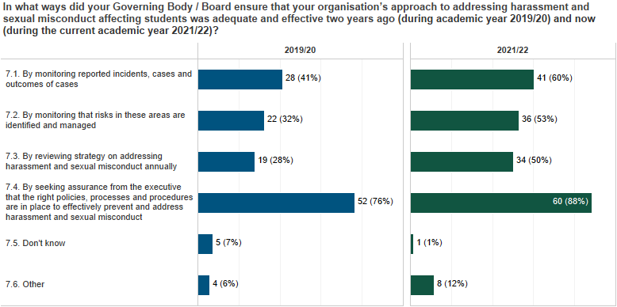
UUK Survey, 2018)

Slide 34
In what ways did your Governing Body / Board ensure that your organisation’s approach to addressing harassment and sexual misconduct affecting students was adequate and effective two years ago compared with now?
Of the 23 comments respondents made about the reasons given for their responses
7 refer to the monitoring role that the Governing Body / Board takes (including for monitoring risk)
8 refer to how the Governing Body / Board receives reports on developments in this area
3 suggest that the Governing Body/Board has a role in approving policies, strategies and procedures
One respondent had appointed a Governor Safeguarding Lead, and another that the Board had completed training in this area
Illustrative comments are shown on the next slide

Slide 35
In what ways does your Governing Body / Board ensure that your organisation’s approach to addressing harassment and sexual misconduct affecting students is adequate and effective now (during current academic year 2021/22)?”
“Our Governing body does not see individual cases; this is part of our Senior Management remit. They do, however have oversight of the process and risk monitoring” FE provider
“Since reviewing the statement updates have been provided on the action plan following the review of expectations. A presentation is planned this summer to provide a further update and the Board now regularly receive and monitor the number of incidents and cases” Other provider
“The close interest of the governor Chair of [the] Student Matters Committee, and the appointment of a Governor Safeguarding Lead has been extremely helpful in driving forward improved governance” Post-1992 provider
“Harassment and sexual misconduct policy is reviewed internally on an annual basis by the SLT and goes to governors if there are significant changes” FE provider
“The Governing body receive comprehensive annual Safeguarding reports. The College has a dedicated Safeguarding Governor who attends termly Safeguarding Committee meetings and provides feedback / assurance to the wider Governing body on all Safeguarding practices at the college. The college corporation annually review and approve the College Child Protection and Safeguarding Policy” FE provider
“In 2019/20 Senate and Executive [team] received information on [the] approach to sexual misconduct and bullying and harassment as part of review of student and staff policies. There is also an annual report to Senate on student cases including those relating to sexual misconduct and bullying and harassment. [The institution] underwent a governance review in 2021/22 and the recommendation from internal audit against OfS Statement of expectations was that 'a termly report might be appropriate’ once governance structures were established. These governance structures have now been agreed and the [relevant] Steering Group reports into the EDI Board which reports into SLT. The EDI Board receives termly reports on B&H and sexual misconduct and this is shared also with Senate as relevant. As part of institutional strategy refresh for 2022 -2027 the work to prevent bullying and harassment and sexual misconduct is being reviewed” Other provider

Slide 36
Which of the following activities has your organisation undertaken as part of your approach to addressing harassment and sexual misconduct affecting students?
Three most frequently highlighted activities
77% of providers said they collaborate with students’ unions or other student bodies and representatives
77% of providers conduct awareness raising campaigns
77% collect data on reported incidents
Three least frequently highlighted activities
Only 9% of providers engage with local schools and colleges through outreach activities to support a joined-up approach
Just 18% publish data on the outcomes of cases
19% publish data on reported incidents
Other highlights include (see also the chart on the next slide)
Two-thirds (66%) of providers have developed an organisation wide approach to address this agenda
One-quarter of providers (25%) say they collect prevalence data
59% of providers have adopted a trauma informed / victim centred approach to tackling harassment and sexual misconduct

Slide 37
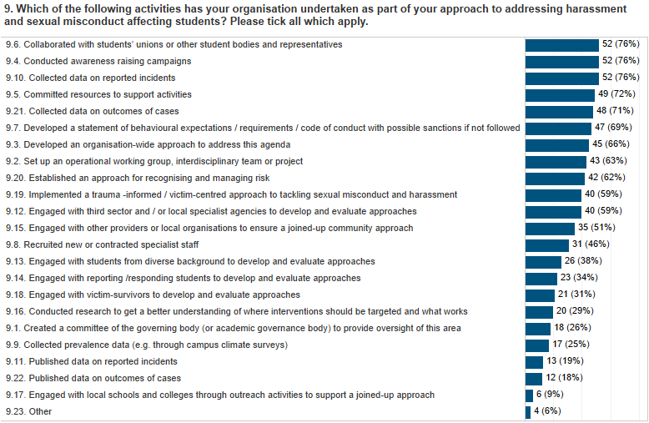

Slide 38
What effect if any has the statement of expectations had on your approach and activities designed to prevent and respond to harassment and sexual misconduct?
50 respondents provided substantive responses to this open question
36 described the effect as providing the opportunity or impetus to review their approach
5 mentioned that it helped to identify gaps in their approach or skills and knowledge
3 mentioned that the SoE encouraged them to take a ‘whole organisation approach’
3 that it encouraged the provider to engage students in co-creation of policies and processes
“The statement of expectations has been the key document that we have used to underpin our work around this agenda. We used it to review and adapt our current strategies, policies and procedures to increase their rigor. It was an excellent tool to use as a self assessment, to identify key areas for development, enabling action planning to continue to embed this agenda with our HE student population. FE college provider
“It has given us a framework and structure for the work already started in 2019 and has helped us address some gaps, including some initiatives moving forward e.g. introducing a Sexual Violence Liaison Officer model.” Post-1992 provider
“One main effect is to clarify the role of the whole organisation including senior leaders in preventing and responding to harassment and sexual misconduct. It has also underlined areas in which we were already well-developed, as well as areas for improvement.” Research-intensive provider
“The University is more actively collaborating with the SU and the wider student body to review and further develop our policies and processes” Post 1992 provider

Slide 39
What staff and student training does your organisation provide to address harassment and sexual misconduct affecting students?
The majority of respondents provide training for students and staff, but in most cases this is not mandatory. Where mandatory training exists, it is for sexual consent training for students, awareness-raising and handling disclosures training for staff.
Staff training for handling incident disclosures – just 70% of respondents have mandatory training for staff in this area
25% stated this is mandatory for all - 45% that this is mandatory for some
23% stated this training is optional
Sexual consent training for students
41% of respondents have this as optional
20% stated that it is mandatory for all
Bystander intervention training for students
7% stated that this is mandatory for all – 19% that this is this is mandatory for some
46% stated this training is optional
Awareness raising training for staff
31% stated this is mandatory for all - 24% that this is mandatory for some
36% stated this training is optional

Slide 40
What staff and student training does your organisation provide to address harassment and sexual misconduct affecting students?

Slide 41
Further details about student and staff training, including whether this has changed over the past two years
Of the 55 responses received, 16 providers has expanded staff training, while 12 indicated they have updated their existing training
Types of training highlighted
Adapting to life in UK –for international students | Sexual consent training | Managing student disclosures | Sexual misconduct first responder
Tackling antisemitism | Tackling cyber bullying | Responding to disclosures of Sexual Violence | Sexual assault/harassment disclosure training
Building a safe and inclusive culture | Diversity & inclusion | Safeguarding | Sexual violence liaison officer training
Bystander intervention training | Handling disciplinary issues | Safeguarding and prevent | Trans Awareness
Bystander train the trainer training |  | Responding to harassment

Slide 42
Further details about student and staff training, including whether this has changed over the past two years
Illustrative comments are shown below
“The University provides a range of training for staff that includes SVLO training, investigation training and panel training. Training provision has increased over the past two years with further contextualisation. A training matrix developed to determine which training required for different staff groups. Training developed for students became mandatory and included in induction over past two year.” Research-intensive provider
“Student Services has had a long-standing staff training programme which is continually reviewed to cover all aspects of this work. In response to the Statement of Expectations this is now being considered across the whole organization with an institutional training strategy in production. The first significant step was to include basic awareness raising within our mandatory Safeguarding Level One course for all staff. As part of this strategy, we are reviewing specialist training for our investigating officers, the People Team, and the student body specifically.” Post 1992 provider
“We previously provided staff with safeguarding and prevent training online but following a review of the statement of expectations we have broadened the training to cover harassment and sexual misconduct and also produced training for students and trustees” Other provider
We have built on our Diversity and Inclusion training to explicitly cover bullying, harassment, hate crime. The College is currently [conducting] intensive activities around anti-racism, which extends to other forms of discrimination and harassment. And is creating standards of behaviour to create more safe and inclusive learning and working environment. We are taking a much more conversational approach in developing staff skills and confidence to recognise and understand what sexual harassment looks like, including daily including sexism body language behaviours and their responsibility in challenging this sort of behaviour. FE provider

Slide 43
Please state whether your organisation has begun implementing the following policies, processes and systems for reporting and disclosing incidents of harassment and misconduct
90% of providers have fully implemented a mechanism for students to report or disclose an incident of harassment or sexual misconduct in person
Staff at 84% of providers are able to signpost or refer students to other organisations where required and requested
16% of providers have not yet started to implement an online mechanism for students to report or disclose an incident of harassment or sexual misconduct
The same proportion (16%) of providers do not have a mechanism for students to make an anonymised report of harassment or sexual misconduct

Slide 44
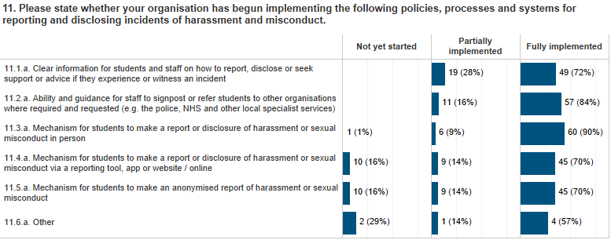
Please state whether your organisation has begun implementing the following policies, processes and systems for reporting and disclosing incidents of harassment and misconduct.

Slide 45
Policies, processes and systems for tackling harassment and sexual misconduct – Comparison with UUK’s 2018 survey
The 2018 Universities UK Changing the Culture survey found that 77% of institutions said they provide clear information for students on how to report – this compares with 100% of institutions who now say they have at least partially implemented this in 2022 (63% say they have fully implemented this)*
In addition, 100% of institutions also now state that staff are able and have and guidance to signpost or refer students to other organisations
In 2018, 83% of institutions said they had improved support for reporting students – this compares with
88% of institutions now have fully implemented an in-person reporting mechanism
74% of institutions now have fully implemented an online reporting mechanism
73% of institutions now have fully implemented anonymised reporting
*UUK’s 2018 survey covered only traditional higher education institutions (HEIs) whereas the survey for the evaluation covered all the types of providers on OfS’s register. Therefore, we used the evaluation survey results from HEIs only for this part of the analysis (excluding FE and other small HE providers) to enable comparison of any changes over time.

Slide 46
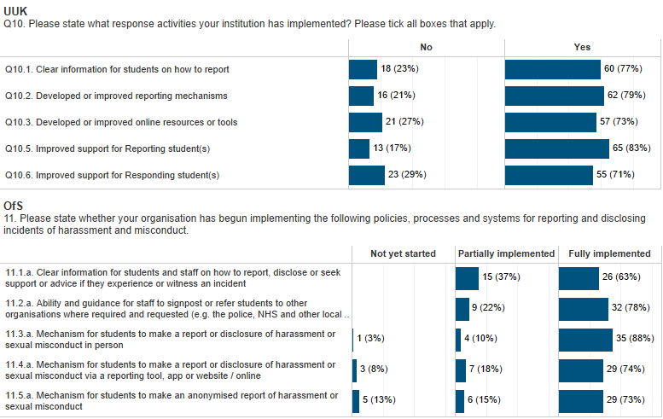
UUK Survey, 2018)

Slide 47
Implementation of policies for tackling harassment and sexual misconduct – Comparison with UUK’s 2018 survey
In the 2018 Universities UK Changing the Culture survey, institutions stated that
94% of student to student sexual misconduct and 92% of staff to student sexual misconduct reporting could be undertaken in-person
These high levels decreased to 81% and 78% respectively for telephone reporting and 65% and 62% respectively for online reporting
The current survey indicates that now in 2022
almost all of the higher education institutions* (98%) enable in-person reporting of incidents
74% enable online reporting
*UUK’s 2018 survey covered only traditional higher education institutions (HEIs) whereas the survey for the evaluation covered all the types of providers on OfS’s register. Therefore, we used the evaluation survey results from HEIs only for this part of the analysis (excluding FE and other small HE providers) to enable comparison of any changes over time.

Slide 48
UUK Survey, 2018)

Slide 49
Please state whether your organisation has begun implementing the following approaches for taking action in response to reports and disclosures of harassment and sexual misconduct
Under two-thirds (63%) of providers have fully implemented the Pinsent Masons guidance on handling situations where a student disciplinary offence may also constitute a criminal offence
19% have partially implemented the guidance
One-fifth of providers 20% have not yet started to implement the guidance
Providers consider other aspects of their approaches positively
95% say they have disciplinary hearings for considering students complaints and appeals
94% say they have a clear and accessible student disciplinary policy
93% say their investigatory process is fair, independent and free from any perceptions of bias

Slide 50
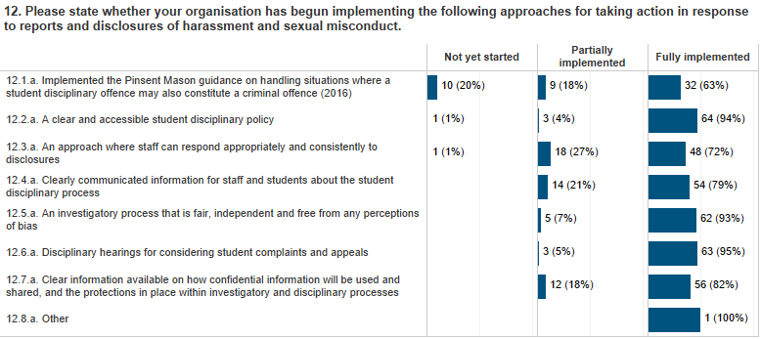

Slide 51
Taking action in response to reports and disclosures – Comparison with UUK’s 2018 survey
In the 2018 Universities UK Changing the Culture survey, just one-third (33%) of respondents stated they had fully implemented the Pinsent Masons guidance on dealing with student behaviour which may constitute a criminal offence
45% of institutions stated they had partially implemented the guidance
In 2022, institutions* report that substantial progress has been made
71% saying they have fully implemented the guidance (noting the proportion for all providers in this survey is lower at 63%), with a further 18% having partially implementing the guidance
*UUK’s 2018 survey covered only traditional higher education institutions (HEIs) whereas the survey for the evaluation covered all the types of providers on OfS’s register. Therefore, we used the evaluation survey results from HEIs only for this part of the analysis (excluding FE and other small HE providers) to enable comparison of any changes over time.

Slide 52
Taking action in response to reports and disclosures – Comparison with UUK’s 2018 survey
UUK Survey, 2018)

Slide 53
Please state whether your organisation provides the following support and information to students involved in reports and disclosures
96% of providers stated that they provide support for students regardless of whether a formal report or complaint is made
91% have fully implemented an approach to support both the reporting and responding students in the event of a disclosure prior to the launch of a formal investigation
73% of providers stated that they have fully implemented communicating the outcome of the investigatory processes and any actions taken to both the reporting and responding student

Slide 54
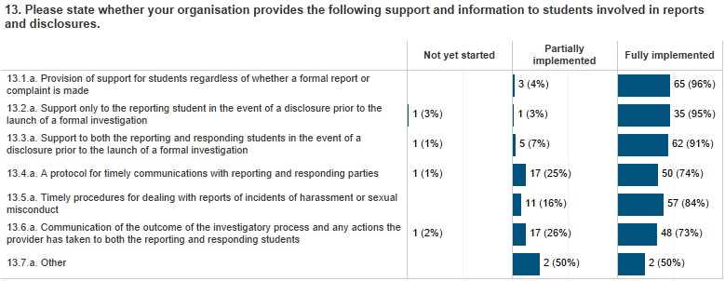
Please state whether your organisation provides the following support and information to students involved in reports and disclosures

Slide 55
What are the main barriers or challenges your organisation faces in the effective prevention of harassment and sexual misconduct affecting students, and / or to responding effectively to incidents of harassment and sexual misconduct when they occur?
Comments made by providers highlighted the 7 elements of the statement of expectations as shown in the figure below
The main barriers and challenges highlighted were firstly around preventing harassment and sexual misconduct and secondly putting in place reporting and disclosure systems, policies and processes
Element of the statement of expectations mentioned | Number of comments
#1 Taking a whole organisation approach | 6
#3 Engaging students and co-creation of policies and processes | 7
#4 Prevention: staff and student training and awareness raising | 17
#5 Reporting and disclosure systems, policies and processes in place | 13
#6 Approach to taking action in response to misconduct | 9
#7 Provision of support to students following reports and disclosures | 6

Slide 56
What are the main barriers or challenges your organisation faces in the effective prevention of harassment and sexual misconduct affecting students, and / or to responding effectively to incidents of harassment and sexual misconduct when they occur?
Where possible comments were compared with the options provided in Q22 of the Universities UK 2018 survey and the results are shown in the figure below – the highest number again focussed on aspects of prevention
UUK survey option | Number of comments
Developing a whole institution approach | 6
Extent to which training for staff and students can be rolled out | 6
Lack of resources | 5
Lack of an evidence base for interventions | 2
Working with survivors to embed the survivors' voice | 2
Responding to an increase in the volume of disclosures | 1

Slide 57
What are the main barriers or challenges your organisation faces in the effective prevention of harassment and sexual misconduct affecting students, and / or to responding effectively to incidents of harassment and sexual misconduct when they occur?
The responses were further coded to capture other details about barriers
Of the 29 responses
8 related to the need for awareness raising of issues around harassment and sexual misconduct as a challenge or barrier
6 comments related to developing students’ trust in their providers’ handling of reports and disclosures
“Ensuring that staff are aware of and apply the relevant policies and procedures consistently can be a barrier” Post 1992 provider
“Speaking to someone they trust in the first instance clarifying that some behaviour constitutes harassment and getting full understanding from potential victim that there is a process in place to report and investigate.” FE provider
“Delays with criminal cases. Low conviction rate for criminal cases.” Research-intensive provider

Slide 58
What further support, guidance or interventions would be helpful for your organisation both to prevent and respond to incidents of harassment and sexual misconduct more effectively in future?
15 comments related to good practice and the sharing of case studies
10 comments related to training
6 related to the availability of networks
4 to GDPR clarification being needed
“More sharing of good practice to know what works as education is just one piece of the puzzle” FE provider
“The effective sharing of what works - we are all trying to fix the same problems, and we should be learning from each other in doing so” Research-intensive university
“Sharing of good practice/toolkits across universities. A platform for universities to work together, learn from one another and develop best practice for the sector” Research-intensive university
“Increased training / webinars and guidance to small HE in FE provision to ensure that we access the correct support and develop appropriate networks” FE provider
“Shared training and resources across the sector would be very helpful” Small & Specialist provider

Slide 59
Appendices
Survey methodology
Survey questions (separate appendix)

Slide 60
Appendix A: Survey methodology
A strong body of supporting evidence was gathered through the research for the evaluation, based on an appropriate mixed method research design for this type of evaluation, and which includes the following key elements:
Drawing on expert opinions gathered from an expert group and from relevant expert individuals, sector organisations and stakeholder groups
Conducting a large quantitative survey (about 25% of OfS registered providers) and extensive qualitative research interviews and focus group discussions with providers, students and their representatives, and victim-survivors.
The online survey of providers was conducted during May 2022
Our sample design involved generating cluster based random samples from the OfS’s register of c400 providers – the clusters were based on the following
Provider type - Research-intensive, Small and specialist, Post-92, FE college, Other provider (>1,000 FTE students), Other provider (<1,000 FTE students)
Provider size using numbers of student FTEs – Very large (>19k), Large (10-19k); Medium (2k-10k); Small (500-2k); Micro (<500)
Region – using the 9 government office regions

Slide 61
Appendix A: Survey methodology
The online survey was sent by OfS on SUMS’ behalf to heads of 100 HE providers (approximately 25% of providers registered with OfS) in May 2022 and responses were submitted to the SUMS’ evaluation team.
The overall response rate to the survey was 68% - with some variation in response by type of provider (ranging from 87% for ‘research-intensive’ providers to 43% for ‘other provider (with >1,000 FTE students)’ (further details about the response are shown in the chart overleaf).
The survey considered the effects of the statement of expectations on providers’ approaches to preventing and responding to harassment and sexual misconduct to date. This was done through a series of quantitative and open-ended questions, some of which probed what changes had taken place over time. Survey questions are in the separate Appendix B.
Additionally, analysis of this survey’s results was compared with some of the findings from comparable questions used by Universities UK in a 2018 survey discussed in the report Changing the Culture: Two Years On.
All responses to this survey were aggregated in SUMS’ analysis and no individual organisation have been or will be identified in any briefings or reports arising from the research. All quotes have been anonymised and any identifying information about organisations removed.

Slide 62
Survey response

Slide 63
FOR FURTHER INFORMATION CONTACT
Helen Baird, Principal Consultant, SUMS
h.m.baird@reading.ac.uk
@SUMSConsulting
SUMS Consulting

